Slide 1
Governance and Compliance

Slide 2
Management Group
Provides a level of scope above subscriptions.
You organize subscriptions into containers called management groups and apply your governance conditions on the management group.

Slide 3
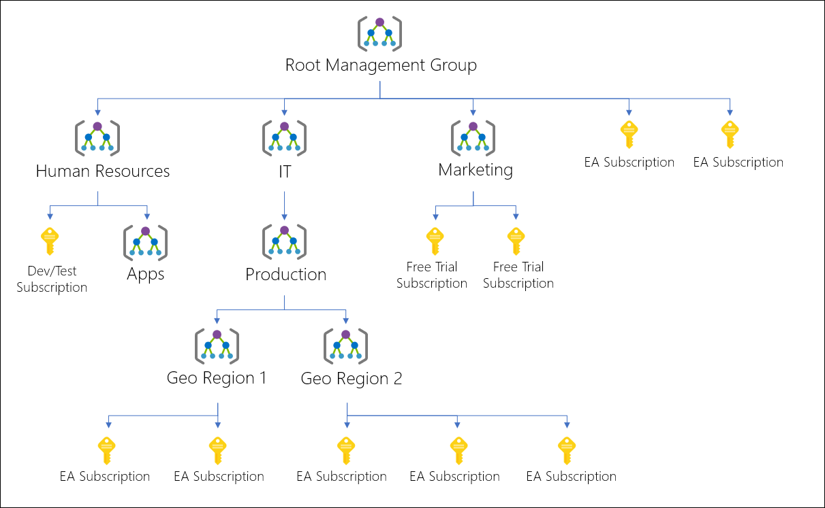

Slide 4
Azure Subscriptions
Billing for Azure Services is done on a per subscription basis.
Users, Groups and Service Principles
Azure Resource in Resource Group
Authentication
& Authorization
Azure Subscriptions
Azure Active Directory

Slide 5
Getting a Subscription
Enterprise Agreement – Upfront Monetary Commitment
ea.azure.com
Resellers – Open Licensing Program
Partners – Design and Implement your solution
Personal
Free Trial Account - $200
Pay As You Go
Student Account
Azure Credits

Slide 6
Check Resource Limit
Check under the subscription

Slide 7
Cost Management and Billing
Get insights on cost and utilization
Cost over time
Forecast
Budgets

Slide 8
Pricing Calculator
Provides estimates in all areas of Azure including compute, networking, storage, web and database.
https://azure.microsoft.com/en-us/pricing/calculator/

Slide 9
Tags
You can apply tags to your Azure resources to logically organize them by categories.
Each tag consists of name value pair.
Ex: Name as Environment and Value as Production

Slide 10
Tags
Tag | Description | Mandatory/Optional
Application Name | Name of Application | M
Environment | Dev, Testing, Prod | M
Cost Center | Cost Center ID | M
Maintenance Window | Patching Window | O
Department | IT, HR | M
Owner | Owner details | M

Slide 11
Azure Policy

Slide 12
Azure Policy
Create, assign and Manage policies.

Slide 13
Advantages
Enforcement and Compliance
Apply policies at scale:
Management Group
Subscription
Resource Group
Remediation

Slide 14
Implementing Azure Policy
Browse Policy Definitions
Create Initiative Definitions – Set of Policy Definitions
Scope the Initiative Definitions
View Policy Evaluation Results

Slide 15
Users and Groups

Slide 16
User Accounts
All users who require access to resources must have a user account.
Types of identity:
Cloud Identity (Azure Active Directory) – Users only exists in Azure AD
Directory-synchronized Identity (Windows Server AD) – Users brought using synchronization activity
Guest Users – Users from outside Azure.

Slide 17









Groups
It helps organize users to make it easier to manage permissions.
Two Types:
Security Group – Security-enabled and are used to assign permission.
Distribution Group – Email applications

Slide 18
Role-based Access Control

Slide 19
RBAC
Capability for you to grant appropriate access to Azure AD users, groups and services.

Slide 20
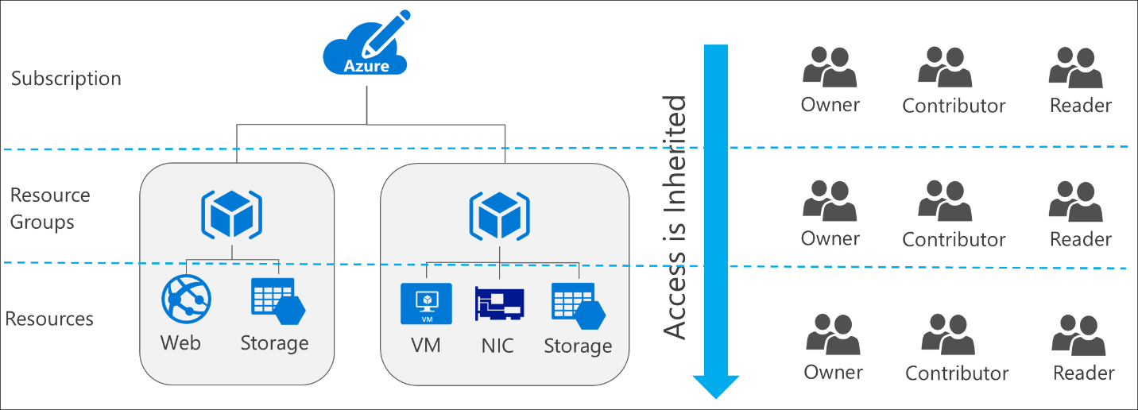
RBAC

Slide 21
RBAC Roles
Owner – Owner can manage everything, including access
Contributor – Manage everything except access
Reader – View everything but cannot make changes

Slide 22
Supriya
Supriya
R
RG
RG
R
Akshay
R
Evan
Sujit
RG
R
Parial
Subscription
R
Amit
RG
R
R

